Slide 1


Introduction to Deep Learning: Training , Optimization, and Regularization
Week 9
السنة الخامسة – هندسة المعلوماتية / الذكاء الصنعي
مقرر التعلم التلقائي
د. رياض سنبل
Access Course Materials

Slide 2
Basic Elements

Slide 3
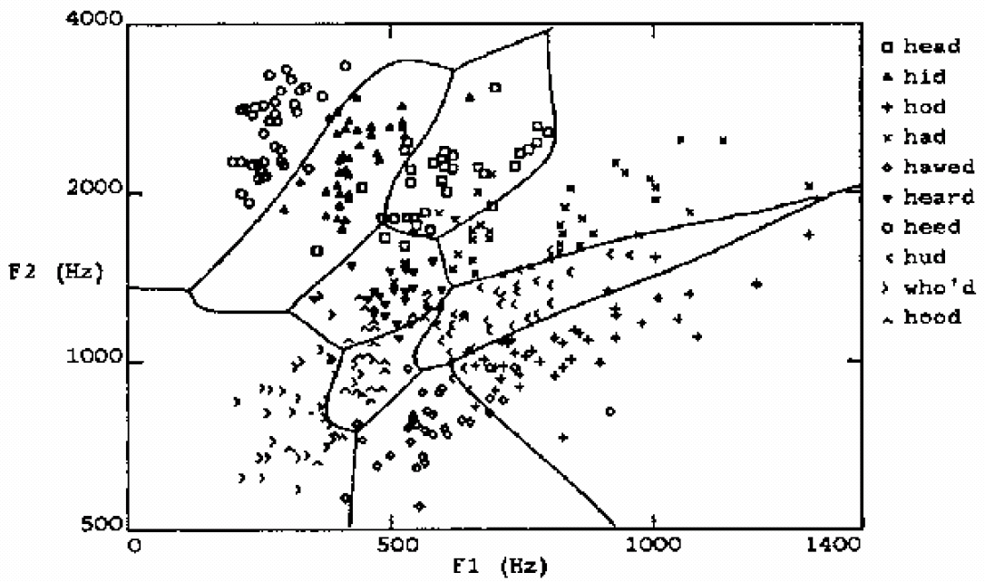
Why Deep Learning?
What kind of discussion boundaries can we learn using:
Decision Trees,
KNN,
SVM
Learning highly non-linear functions

Slide 4
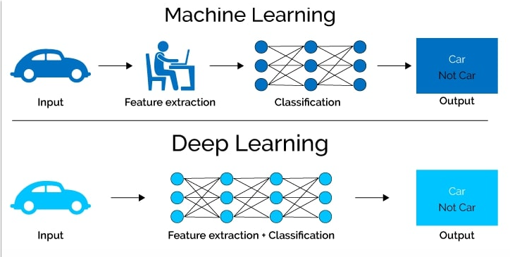
What is Deep Learning?
can we learn underlying features directly from data

Slide 5
Neural Networks (NNs)
Multilayer NN, function f maps inputs x to outputs y, i.e., $y=f(x)$
……
y₁
W¹
W²
W^{L}
y₂
……
b¹
b²
b^{L}
……
……
……
……
……
x
a¹
a²
y
……
y_{M}
y
x
W^{L}
…
W²
W¹
x
b¹
b²
…
b^{L}
$$=f\left( \right)$$
+
+
$$=σ\left( \right)$$
$$σ\left( \right)$$
+
$$σ\left( \right)$$

Slide 6
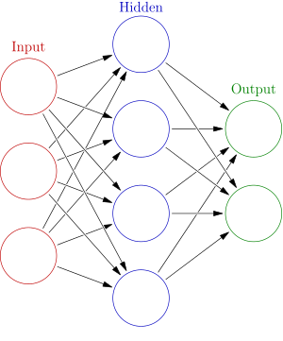
Elements of Neural Networks
An NN with one hidden layer and one output layer
Weights
Biases
$$hidden layer h=σ(W_{1}x+b_{1})$$
$$output layer y=σ(W_{2}h+b_{2})$$
Activation functions
learnable parameters?
4 + 2 = 6 neurons (not counting inputs)
[3 × 4] + [4 × 2] = 20 weights
4 + 2 = 6 biases
26 learnable parameters
$$y$$
$$x$$

Slide 7
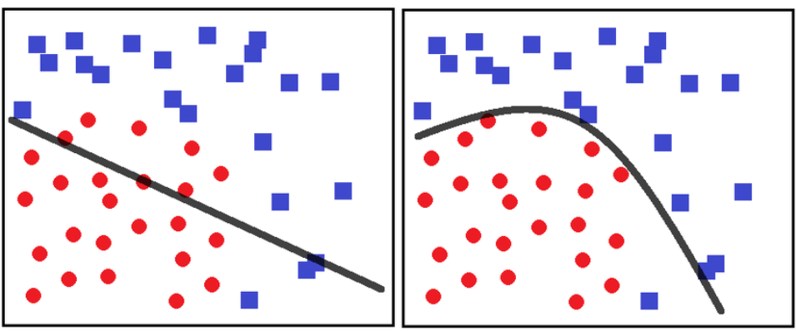
Matrix Operation
Multilayer NN, function f maps inputs x to outputs y, i.e., $y=f(x)$
……
y₁
Activation Functions
the role of activation function is to introduce non-linearity into the network
W¹
W²
W^{L}
y₂
……
b¹
b²
b^{L}
……
……
……
……
……
x
a¹
a²
y
……
y_{M}
y
x
W^{L}
…
W²
W¹
x
b¹
b²
…
b^{L}
$$=f\left( \right)$$
+
+
$$=σ\left( \right)$$
$$σ\left( \right)$$
+
$$σ\left( \right)$$

Slide 8
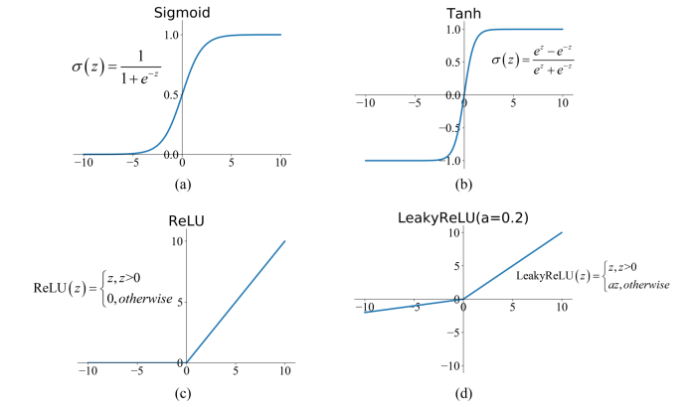
Activation Functions
Most modern deep NNs use ReLU or Leaky ReLU activations
fast to compute compared to sigmoid, tanh
Accelerates the convergence of gradient descent
Prevents the gradient vanishing problem

Slide 9
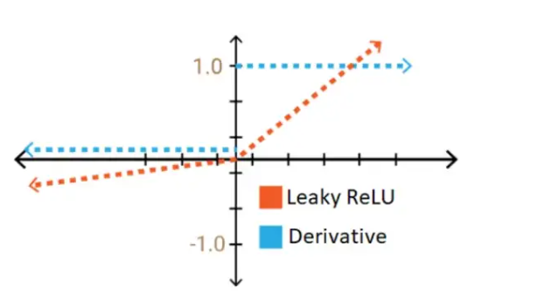
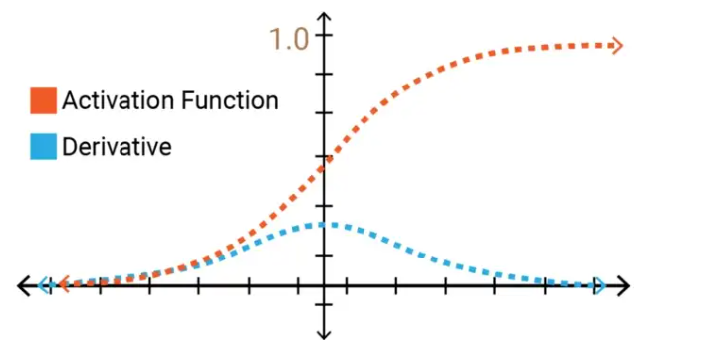
Gradient Vanishing Problem
Vanishing gradient problem is a phenomenon that occurs during the training of deep neural networks, where the gradients that are used to update the network become extremely small or "vanish" as they are backpropogated from the output layers to the earlier layers.

Slide 10
Training NNs
Notes:
Adopted from slides by Ke Chen from University of Manchester and YangQiu Song from MSRA

Slide 11

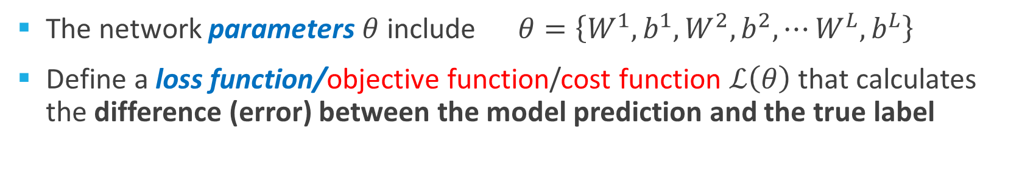

Training NNs
The network parameters $θ$ include $θ=\left\{W^{1},b^{1},W^{2},b^{2},⋯W^{L},b^{L}\right\}$
Define a loss function/objective function/cost function $ℒ\left(θ\right)$ that calculates the difference (error) between the model prediction and the true label
……
y₁
1
0.2
……
y₂
0
0.3
……
……
……
Cost
……
……
……
……
y₁₀
$$ℒ(θ)$$
0
0.5
True label “1”

Slide 12
Loss Functions
Classification tasks
$$ℒ\left(θ\right)=−\frac{1}{N}\sum_{i=1}^{N}{\sum_{k=1}^{K}{\left[y_{k}^{(i)}\log{{\hat{y}}_{k}^{(i)}+\left(1−y_{k}^{(i)}\right) }\log\left(1− {\hat{y}}_{k}^{\left(i\right)}\right)\right]}}$$
Cross-entropy
Ground-truth class labels $y_{i}$ and model predicted class labels ${\hat{y}}_{i}$
Regression tasks
$$ℒ\left(θ\right)= \frac{1}{n}\sum_{i=1}^{n}{{\left(y^{(i)}−{\hat{y}}^{(i)}\right)}^{2}}$$
Mean Squared Error
$$ℒ\left(θ\right)= \frac{1}{n}\sum_{i=1}^{n}{\left|y^{(i)}−{\hat{y}}^{(i)}\right|}$$
Mean Absolute Error

Slide 13

Gradient Descent Algorithm
Steps in the gradient descent algorithm:
Randomly initialize the model parameters$,θ^{0}$
Compute the gradient of the loss function at the initial parameters $θ^{0}$: $∇ℒ\left(θ^{0}\right)$
Update the parameters as:
$$θ^{new}=θ^{0}−α∇ℒ\left(θ^{0}\right)$$
Where α is the learning rate
Go to step 2 and repeat
Total
Loss $L$
Notes:
Consider a parameter w in $θ$

Slide 14
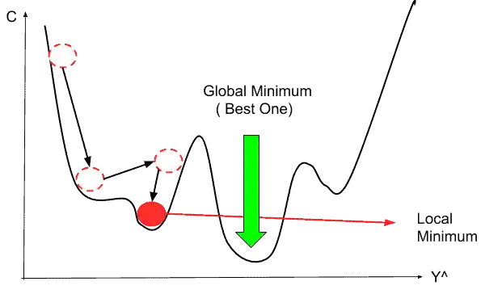
Gradient Descent Algorithm
Gradient descent algorithm stops when a local minimum of the loss surface is reached
GD does not guarantee reaching a global minimum
However, empirical evidence suggests that GD works well for NNs

Slide 15
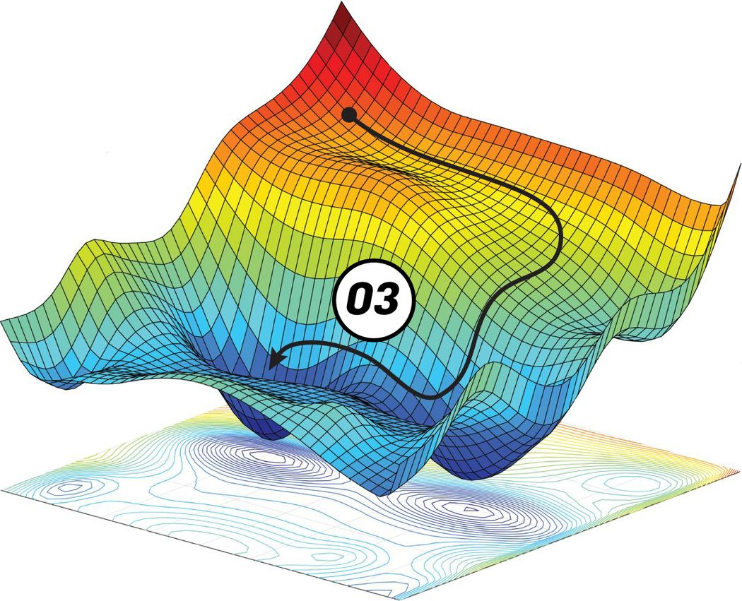
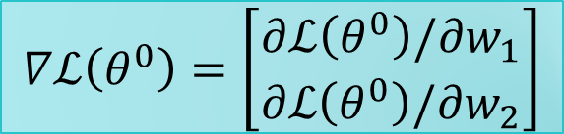




Gradient Descent Algorithm
Example: a NN with only 2 parameters $w_{1}$ and $w_{2}$, i.e., $θ=\left\{w_{1},w_{2}\right\}$
The different colors represent the values of the loss (minimum loss$θ^{∗}$ is ≈ 1.3)
$$θ^{0}$$
$$θ^{new}=θ^{0}−α∇ℒ\left(θ^{0}\right)$$
$$∇ℒ\left(θ^{0}\right)=\left[\begin{matrix}∂ℒ\left(θ^{0}\right)/∂w_{1} \\ ∂ℒ\left(θ^{0}\right)/∂w_{2}\end{matrix}\right]$$
$$θ^{∗}$$

Slide 16
Backpropagation
Forward propagation (forward pass) refers to passing the inputs $x$ through the hidden layers to obtain the model outputs (predictions) $y$
The loss $ℒ\left(y,\hat{y}\right)$ function is then calculated
Backpropagation traverses the network in reverse order, from the outputs $y$ backward toward the inputs $x$ to calculate the gradients of the loss$∇ℒ\left(θ\right)$
Each update of the model parameters $θ$ during training takes one forward and one backward pass (e.g., of a batch of inputs)

Slide 17
Optimization in Deep Neural Networks: More Advanced Concepts
Notes:
Adopted from slides by Ke Chen from University of Manchester and YangQiu Song from MSRA

Slide 18
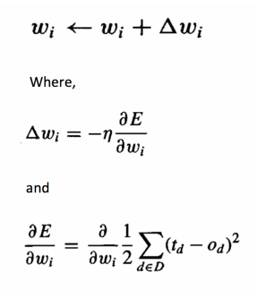
Problem 1
It is wasteful to compute the loss over the entire training dataset to perform a single parameter update for large datasets
E.g., ImageNet has 14M images

Slide 19
Mini-batch Gradient Descent
Therefore, GD (a.k.a. vanilla or standard GD) is almost always replaced with mini-batch GD
Mini-batch gradient descent
Approach:
Compute the loss $ℒ\left(θ\right)$ on a mini-batch of data, update the parameters $θ$, and repeat until all data are used
At the next epoch, shuffle the training data, and repeat the above process
Mini-batch GD results in much faster training
Example: 32 to 256 images
It works because the gradient from a mini-batch is a good approximation of the gradient from the entire training set

Slide 20
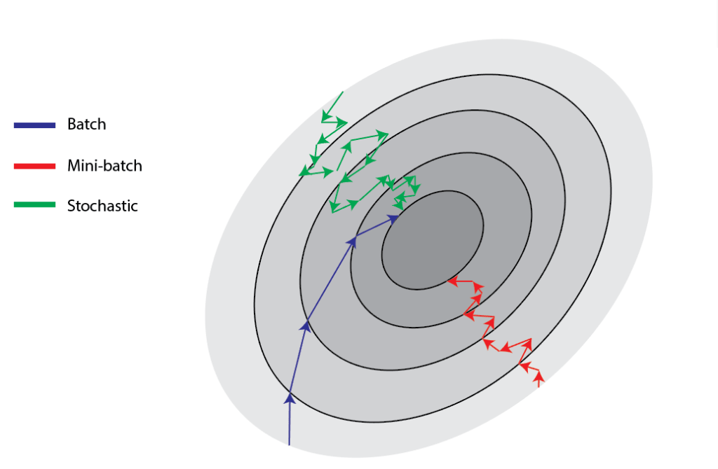
Stochastic Gradient Descent
Stochastic gradient descent
SGD uses mini-batches that consist of a single input example
E.g., one image mini-batch
Although this method is very fast, it may cause significant instabilities in the loss function
Therefore, it is less commonly used, and mini-batch GD is preferred
In most DL libraries, SGD typically means a mini-batch GD (with an option to add momentum).

Slide 21
Problem 2
Besides the local minima problem, the GD algorithm can be very slow at plateaus, and it can get stuck at saddle points
cost $ℒ\left(θ\right)$
Very slow at the plateau
Stuck at a saddle point
Stuck at a local minimum
$$∇ℒ\left(θ\right)≈0$$
$$∇ℒ\left(θ\right)=0$$
$$∇ℒ\left(θ\right)=0$$
$$θ$$

Slide 22
Gradient Descent with Momentum
Gradient descent with momentum uses the momentum of the gradient for parameter optimization
cost $ℒ\left(θ\right)$
Movement = Negative of Gradient + Momentum
Negative of Gradient
Momentum
Real Movement
$$θ$$
Gradient = 0

Slide 23
Gradient Descent with Momentum
Parameters update in GD with momentum at iteration $t$: $θ^{t}=θ^{t−1}−V^{t}$
Where: $V^{t}$= $βV^{t−1}+α∇ℒ\left(θ^{t−1}\right)$
I.e., $θ^{t}=θ^{t−1}−α∇ℒ\left(θ^{t−1}\right)−βV^{t−1}$
Compare to vanilla GD: $θ^{t}=θ^{t−1}−α∇ℒ\left(θ^{t−1}\right)$
Where $θ^{t−1}$ are the parameters from the previous iteration $t−1$
The term $V^{t}$ is called momentum
This term accumulates the gradients from the past several steps, i.e.,
$V^{t}$= $βV^{t−1}+α∇ℒ\left(θ^{t−1}\right)$
$$=β\left(βV^{t−2}+α∇ℒ\left(θ^{t−2}\right)\right)+α∇ℒ\left(θ^{t−1}\right)$$
$$=β^{2}V^{t−2}+βα∇ℒ\left(θ^{t−2}\right)+α∇ℒ\left(θ^{t−1}\right)$$
$$=β^{3}V^{t−3}+β^{2}α∇ℒ\left(θ^{t−3}\right)+βα∇ℒ\left(θ^{t−2}\right)+α∇ℒ\left(θ^{t−1}\right)$$

Slide 24
Gradient Descent with Momentum
Vanilla GD: $θ^{t}=θ^{t−1}−α∇ℒ\left(θ^{t−1}\right)$
GD with momentum: $θ^{t}=θ^{t−1}−V^{t}=θ^{t−1}−(α∇ℒ\left(θ^{t−1}\right)+βV^{t−1})$
$$V^{t}=β^{3}V^{t−3}+β^{2}α∇ℒ\left(θ^{t−3}\right)+βα∇ℒ\left(θ^{t−2}\right)+α∇ℒ\left(θ^{t−1}\right)$$
This method updates the parameters $θ$ in the direction of the weighted average of the past gradients
This term momentum is analogous to a momentum of a heavy ball rolling down the hill
The parameter$β$ is referred to as a coefficient of momentum
A typical value of the parameter $β$ is 0.9

Slide 25
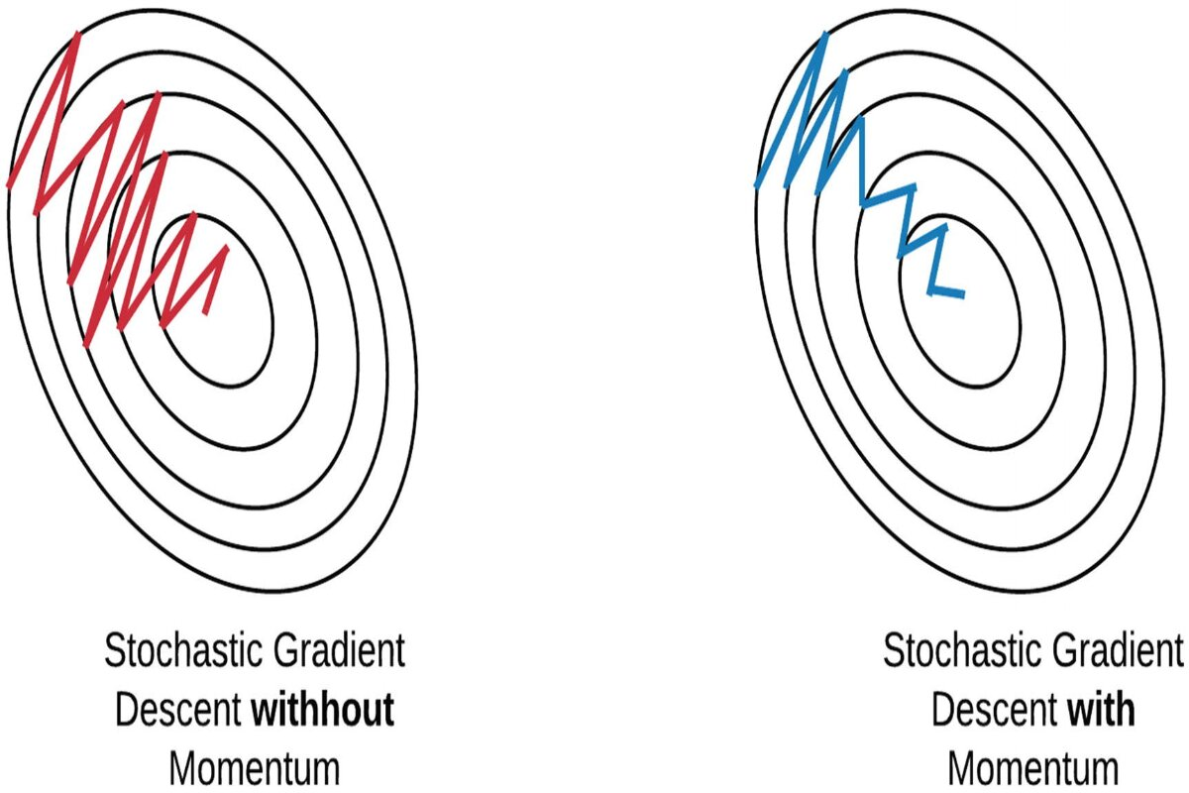
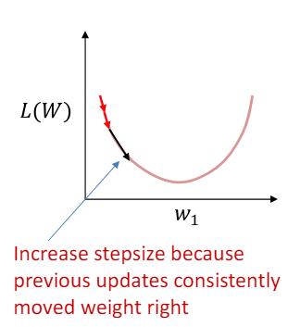
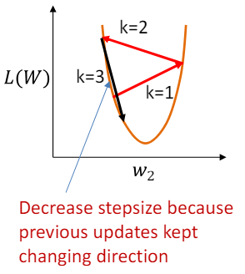
Another reason to use Momentum
Reducing the oscillations in the optimization path
Shrink step size in directions where the weight oscillates
Expand step size in directions where the weight moves consistently in one direction

Slide 26
Nesterov Accelerated Momentum
Gradient descent with Nesterov accelerated momentum
Parameter update: $θ^{t}=θ^{t−1}−V^{t}$
Where: $V^{t}$= $βV^{t−1}+α∇ℒ\left(θ^{t−1}+βV^{t−1}\right)$
The term $θ^{t−1}+βV^{t−1}$ allows to predict the position of the parameters in the next step (i.e., $θ^{t} ≈θ^{t−1}+βV^{t−1}$)
The gradient is calculated with respect to the approximate future position of the parameters in the next iteration, $θ^{t}$, calculated at iteration $t−1$
Classical momentum: (1) Correct your velocity and (2) make a big step according to that velocity (and then repeat),
Nesterov momentum: (1) Make a step into velocity direction and (2) make a correction to a velocity vector based on new location (then repeat).

Slide 27
Adaptive Moment
Storing an exponentially decaying average of past squared gradients s like Adadelta and RMSprop.
Other commonly used optimization methods include:
Adam, Adagrad, Adadelta, RMSprop, Nadam, etc.
Most commonly used optimizers nowadays are Adam and SGD with momentum

Slide 28
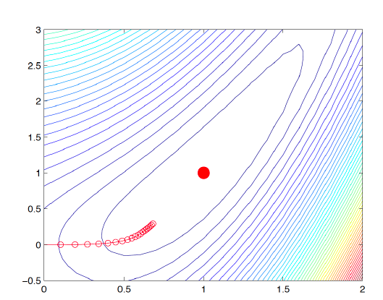
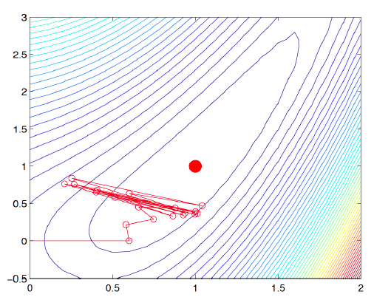
Problem 3:
Learning rate
The gradient tells us the direction in which the loss has the steepest rate of increase, but it does not tell us how far along the opposite direction we should step
Choosing the learning rate (also called the step size) is one of the most important hyper-parameter settings for NN training
LR too small
LR too large

Slide 29
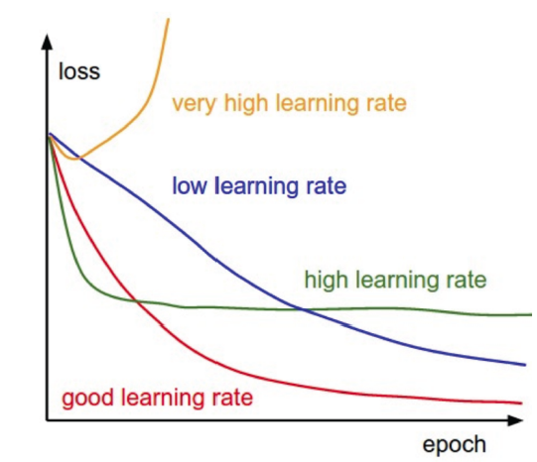
Learning Rate
Training loss for different learning rates
High learning rate: the loss increases or plateaus too quickly
Low learning rate: the loss decreases too slowly (takes many epochs to reach a solution)

Slide 30
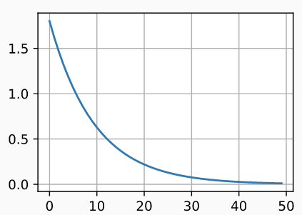
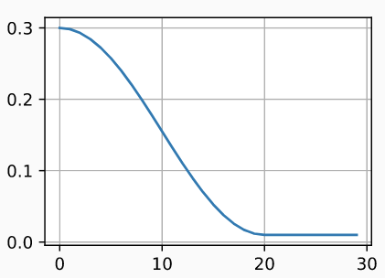
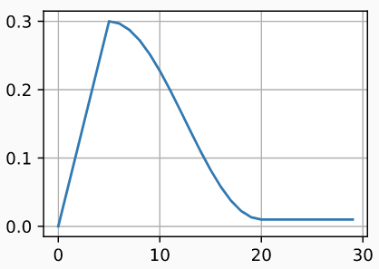
Learning Rate Scheduling
Learning rate scheduling is applied to change the values of the learning rate during the training
Annealing is reducing the learning rate over time (a.k.a. learning rate decay)
Approach 1: reduce the learning rate by some factor every few epochs
Typical values: reduce the learning rate by a half every 5 epochs, or divide by 10 every 20 epochs
Approach 2: exponential or cosine decay gradually reduce the learning rate over time
Approach 3: reduce the learning rate by a constant (e.g., by half) whenever the validation loss stops improving
Warmup is gradually increasing the learning rate initially, and afterward let it cool down until the end of the training
Exponential decay
Cosine decay
Warmup

Slide 31
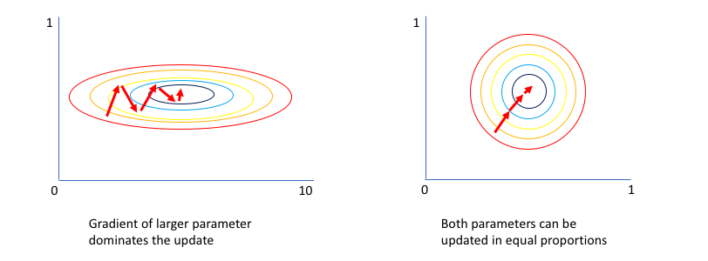
Problem 4: Unnormalized Data
It can lead toward an awkward loss function topology which places more emphasis on certain parameter gradients.
Example: The first input value, x1, varies from 0 to 1 while the second input value, x2, varies from 0 to 0.01. Since your network is tasked with learning how to combine these inputs through a series of linear combinations and nonlinear activations, the parameters associated with each input will also exist on different scales.

Slide 32
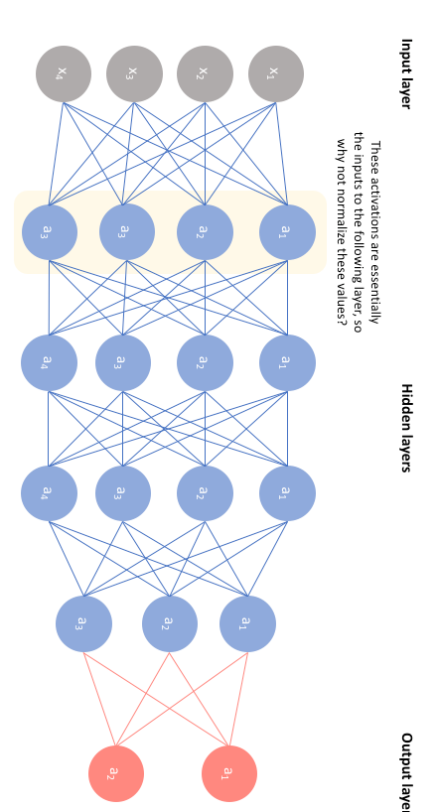
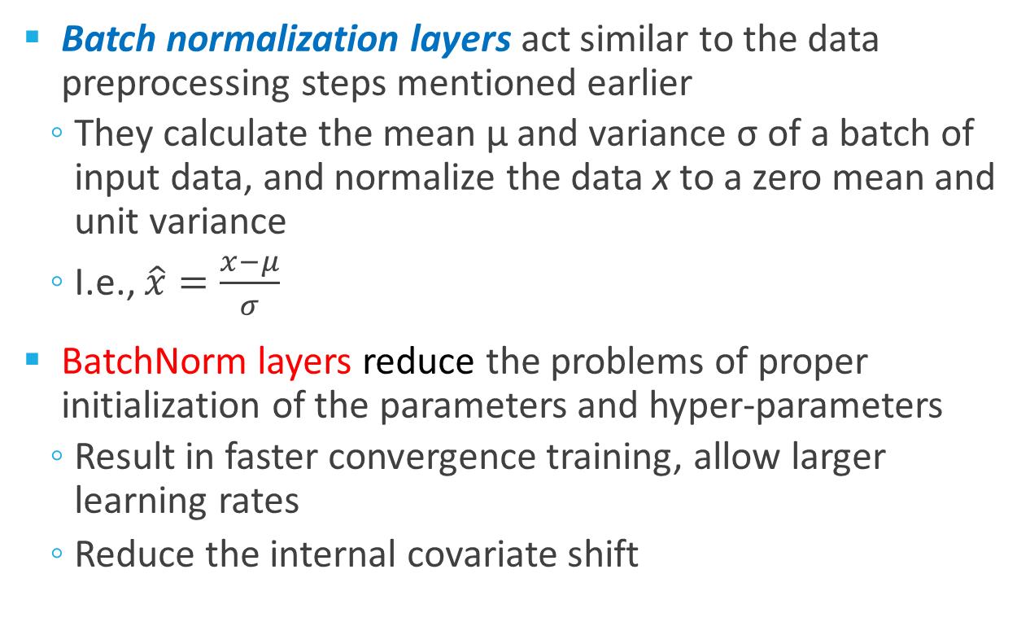
Batch Normalization
Batch normalization layers act similar to the data preprocessing steps mentioned earlier
They calculate the mean μ and variance σ of a batch of input data, and normalize the data x to a zero mean and unit variance
I.e., $\hat{x}=\frac{x−μ}{σ}$
BatchNorm layers reduce the problems of proper initialization of the parameters and hyper-parameters
Result in faster convergence training, allow larger learning rates
Reduce the internal covariate shift

Slide 33
Generalization in Deep Neural Networks Regularization Techniques
Notes:
Adopted from slides by Ke Chen from University of Manchester and YangQiu Song from MSRA

Slide 34
Regularization Techniques in Deep Learning
Regularization is a set of techniques that can prevent overfitting in neural.
How to introduce regularization in deep learning models?
Weight Decay
Dropout
Data Augmentation
Early Stop

Slide 35
(1) Weight Decay
Overfitting may occur when you train a neural network too long.
Neural networks that have been over-trained are often characterized by having weights that are large.
A good NN might have weight values that range between -5.0 to +5.0 but a NN that is overfitted might have some weight values such as 25.0 or -32.0.
So, one approach for discouraging overfitting is to prevent weight values from getting large in magnitude.
Weight decay can be implemented by modifying the update rule for the weights such that the gradient is not only based on the training data but also on the weight decay term.

Slide 36
(1) Weight Decay
$ℓ_{2}$ weight decay
$$ℒ_{reg}\left(θ\right)= ℒ\left(θ\right)+λ\sum_{k}{θ_{k}^{2}}$$
$ℓ_{1}$ weight decay
$ℒ_{reg}\left(θ\right)= ℒ\left(θ\right)+λ\sum_{k}{\left|θ_{k}\right|}$
$ℓ_{1}$ weight decay is less common with NN
Often performs worse than $ℓ_{2}$ weight decay
It is also possible to combine $ℓ_{1}$ and $ℓ_{2}$ regularization
Called elastic net regularization
$ℒ_{reg}\left(θ\right)= ℒ\left(θ\right)+λ_{1}\sum_{k}{\left|θ_{k}\right|+λ_{2}\sum_{k}{θ_{k}^{2}}}$
The weight decay coefficient $λ$determines how dominant the regularization is during the gradient computation

Slide 37
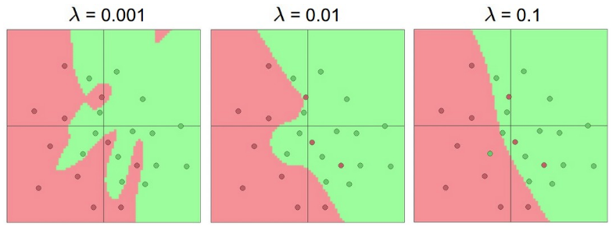
(1) Weight Decay
Effect of the decay coefficient $λ$
Large weight decay coefficient → penalty for weights with large values

Slide 38
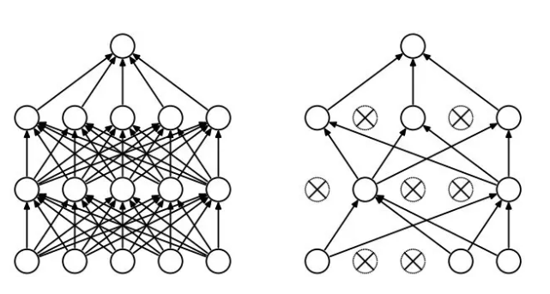
(2) Dropout
Overfitting may occur when Network layers co-adapt to correct mistakes from prior layers, in turn making the model more robust.
units may change in a way that they fix up the mistakes of the other units.
This may lead to complex co-adaptations.
At every iteration, we randomly selects some nodes and (temporary) removes them along with all of their incoming and outgoing connections as shown below.
It increases the sparsity of the network and in general, encourages sparse representations!

Slide 39
(2) Dropout
Each unit is retained with a fixed dropout rate p, independent of other units
The hyper-parameter p needs to be chosen (tuned)
Often, between 20% and 50% of the units are dropped
During test time, all units are present

Slide 40
(2) Dropout
Dropout is a kind of ensemble learning
Using one mini-batch to train one network with a slightly different architecture
minibatch
1
minibatch
2
minibatch
3
minibatch
n
……

Slide 41
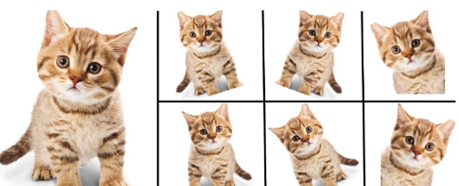
(3) Data Augmentation
The simplest way to reduce overfitting is to increase the size of the training data.
In machine learning, we were not able to increase the size of training data as the labeled data was too costly.
Solution: creating new training examples by applying random transformations to your existing data,
Example: in computer vision => rotating, cropping, or flipping images.

Slide 42
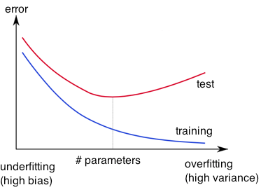
(4) Early Stopping
Early-stopping
During model training, use a validation set
Stop when the validation accuracy (or loss) has not improved after n epochs
The parameter n is called patience
Stop training
validation

Slide 43
Hyper-parameter Tuning
Training NNs can involve setting many hyper-parameters
The most common hyper-parameters include:
Number of layers, and number of neurons per layer
Initial learning rate
Learning rate decay schedule (e.g., decay constant)
Optimizer type
Other hyper-parameters may include:
Regularization parameters ($ℓ_{2}$ penalty, dropout rate)
Batch size
Activation functions
Loss function
Hyper-parameter tuning can be time-consuming for larger NNs

